Slide 1
Vectors
Gradient Descent

Slide 2
Outline
Definitions
Intuitive Explanation
Gradient Descent for a Two-Variable Function

Slide 3
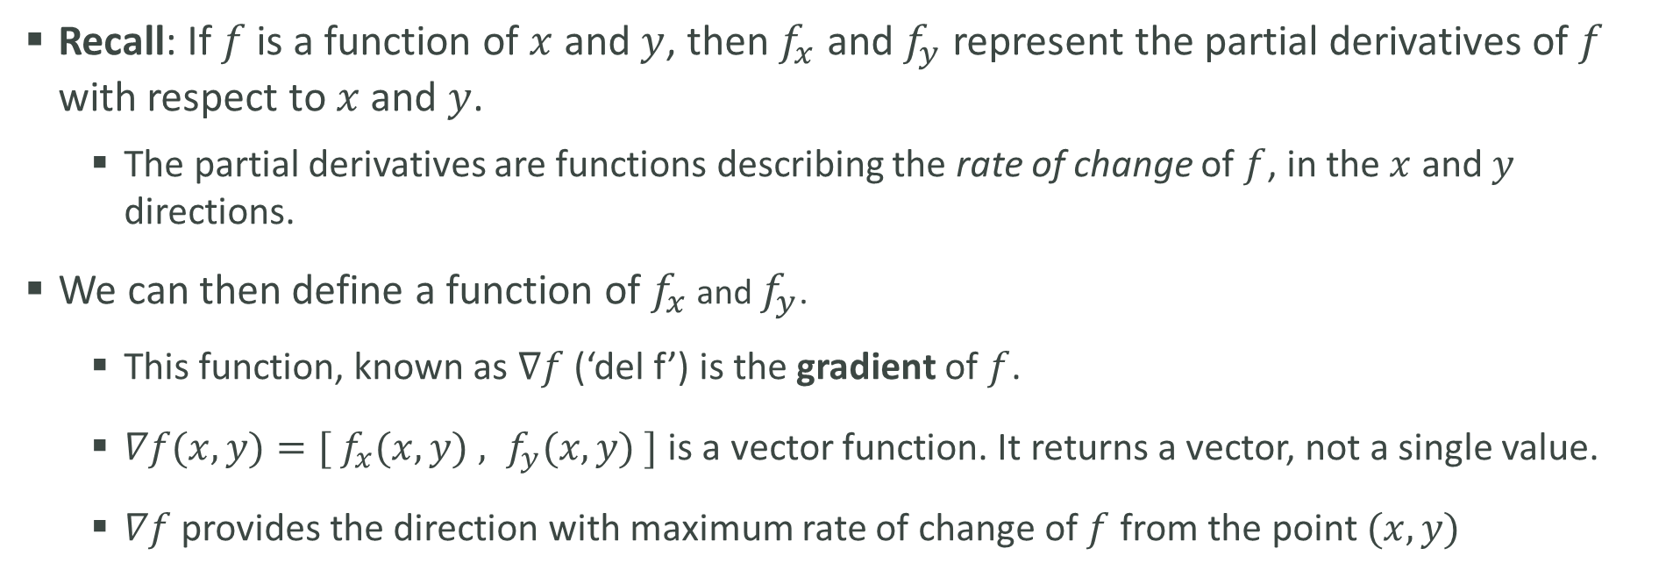
Definitions
Recall: If $f$ is a function of $x$ and $y$, then $f_{x}$ and $f_{y}$ represent the partial derivatives of $f$ with respect to $x$ and $y$.
The partial derivatives are functions describing the rate of change of $f$, in the $x$ and $y$ directions.
We can then define a function of $f_{x}$ and $f_{y}$.
This function, known as $∇f$ (‘del f’) is the gradient of $f$.
$∇f(x, y)=[ f_{x}(x,y) , f_{y}(x,y) ]$ is a vector function. It returns a vector, not a single value.
$∇f$ provides the direction with maximum rate of change of $f$ from the point $(x, y)$

Slide 4
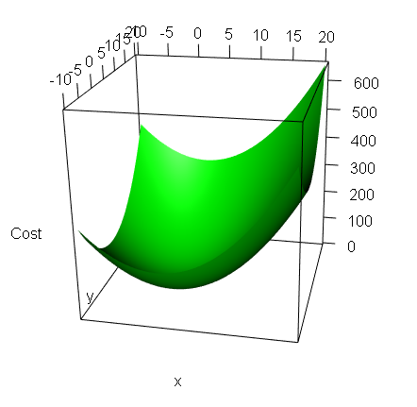
Intuitive Explanation
Imagine you are standing on the side of a mountain and wish to hike to the bottom. However, you are blindfolded and cannot see which direction to walk.
By testing the pitch (slope) of all directions around you, you can select the direction that descends most quickly.
Every few steps, you stop and check all surrounding slopes again, and adjust course as necessary.
Gradient descent works exactly like this, but from a starting point on a curve to the minimum (or maximum).

Slide 5
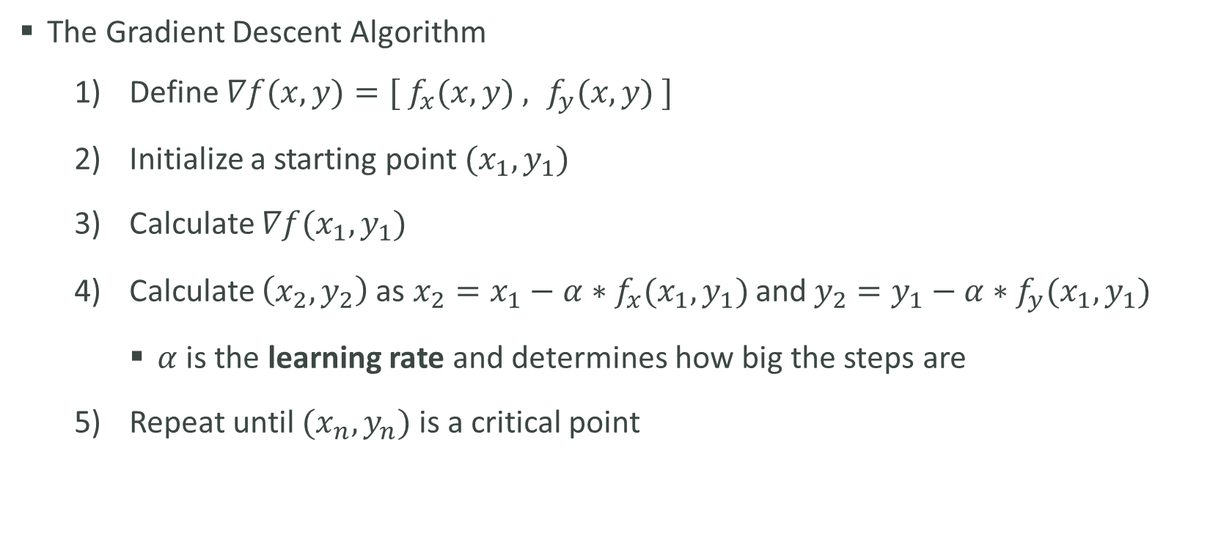
Technical Explanation
The Gradient Descent Algorithm
Define $∇f(x, y)=[ f_{x}(x,y) , f_{y}(x,y) ]$
Initialize a starting point $(x_{1},y_{1})$
Calculate $∇f(x_{1}, y_{1})$
Calculate $\left(x_{2},y_{2}\right)$ as $x_{2}=x_{1}−α∗f_{x}(x_{1},y_{1})$ and $y_{2}=y_{1}−α∗f_{y}(x_{1},y_{1})$
$α$ is the learning rate and determines how big the steps are
Repeat until $(x_{n},y_{n})$ is a critical point

